Slide 1
Rice Leaf Disease Detection using CNN

Slide 2
agenda
Introduction & Problem Statement Importance of rice, common diseases, and challenges in manual detection
Objectives Goals of building an AI-powered detection system
Dataset & Methodology Data preparation, preprocessing, and model workflow
Results & Impact Model accuracy, performance, and benefits for farmers
Conclusion & Future Scope Key outcomes and how this project can be expanded

Slide 3

Problem statement

Slide 4
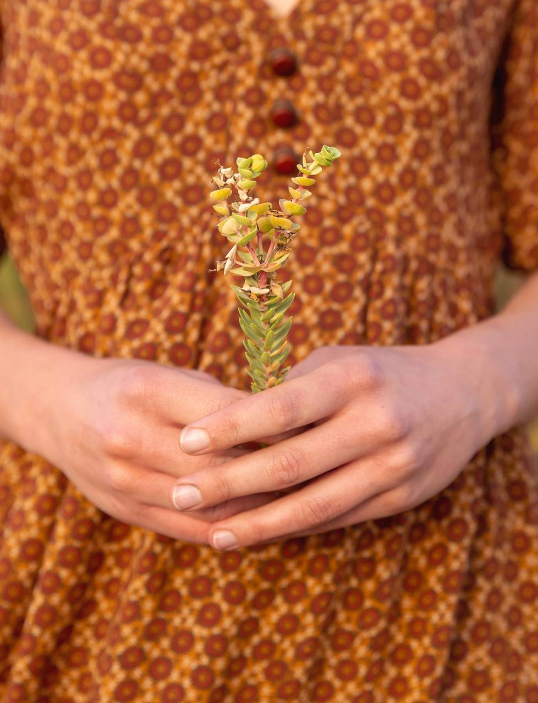
Major rice leaf diseases: Leaf Smut Brown Spot Bacterial Leaf Blight Current detection Manual identification Time-consuming Error-prone Requires expert knowledge Farmers lack fast, reliable methods to identify diseases.

Slide 5
Objective
Automate classification of rice leaf diseases using image data.
Apply deep learning (CNN/Transfer Learning).
Support farmers with early detection and prevention.
Reduce crop loss and improve food security.

Slide 6
Dataset
Dataset contains 3 classes:
Leaf Smut
Brown Spot
Bacterial Leaf Blight
Each class includes labeled leaf images.
Preprocessing applied:
Resizing images
Normalization
Data Augmentation (rotation, flip, zoom)
Data split into Training ,Validation , and Test sets

Slide 7
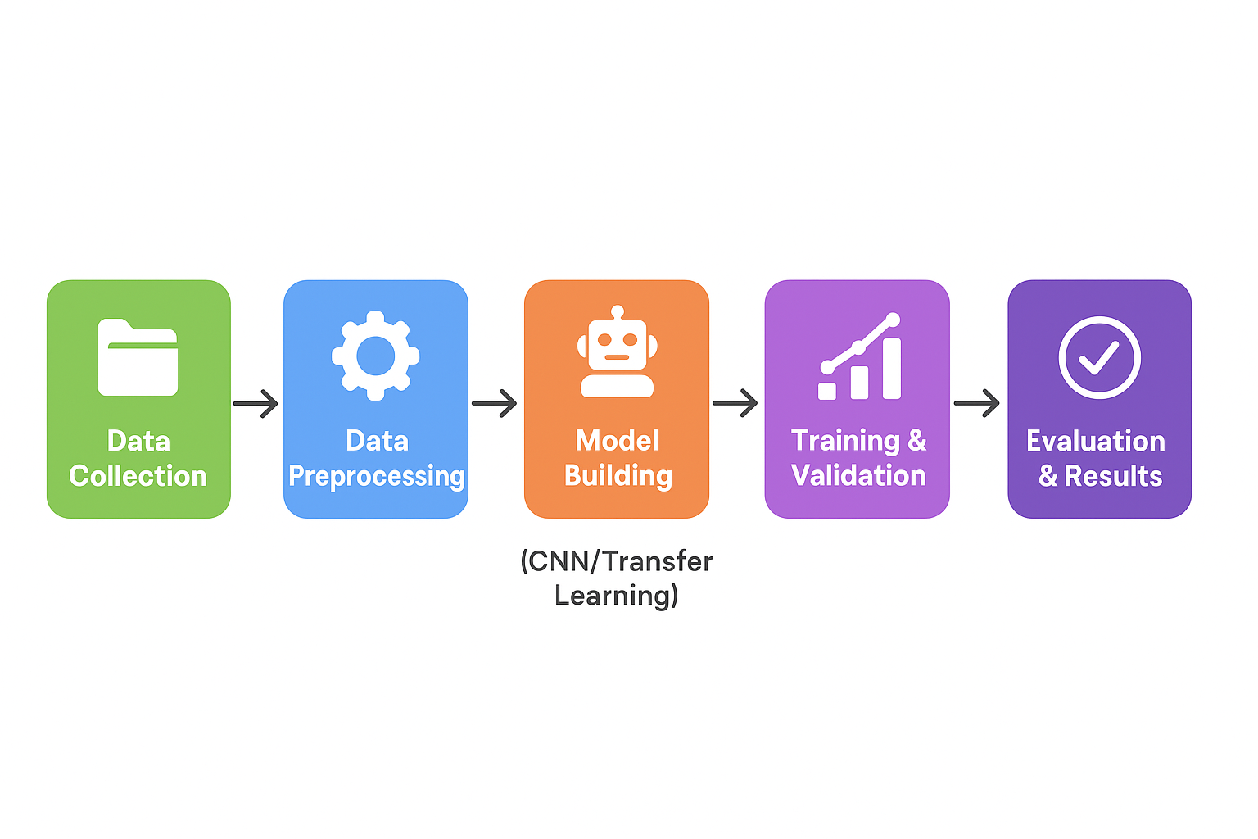
Methodology (Workflow)
Data Collection
Preprocessing
Model Building
Training & Validation
Evaluation & Results

Slide 8
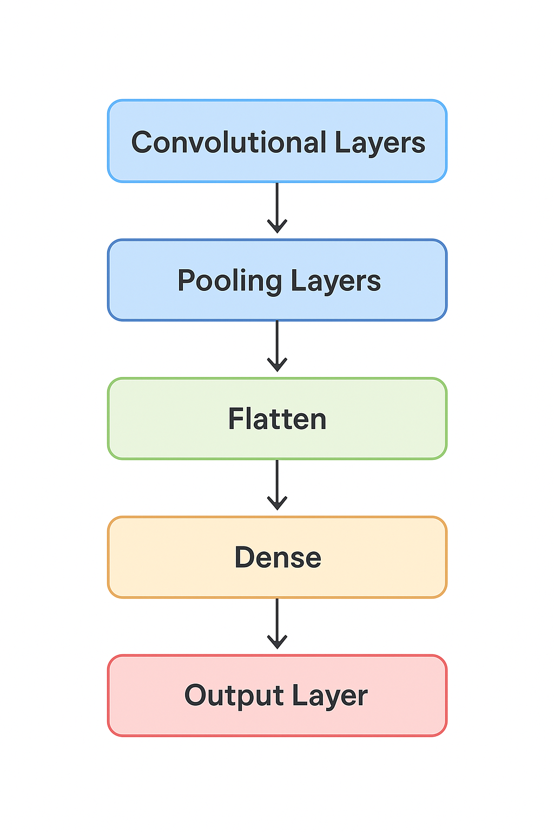
Model Architecture
CNN model design:
Convolutional Layers → Pooling Layers → Flatten → Dense → Output Layer
Optimizer: Adam / SGD
Loss Function: Categorical Cross-Entropy
Activation Functions: ReLU, Softmax

Slide 9
Results
Accuracy achieved: (Best Accuracy Achieved: 66.7%
Top Performing Models:
CNN-2 (Medium + Dropout) → 66.7%
MobileNetV2 (Frozen) → 66.7%
Other models:
CNN-1 (Shallow) → 61.1%
CNN-0 (Very Simple) → 38.9%
Confusion Matrix shows classification performance.
Training vs Validation curves confirm proper learning.

Slide 10
speaking impact
Enables farmers to detect diseases early.
Reduces crop losses and improves yield.
Can be deployed as a mobile or web-based application.
Scalable to detect more diseases and other crops.

Slide 11
Conclusion
Built a deep learning model for rice leaf disease detection.
Achieved promising accuracy.
Demonstrated feasibility of AI in agriculture.
Future Scope:
Expand dataset with more diseases.
Deploy system as a real-time app for farmers.

Slide 12
Thank you

